Slide 1
GROUP 17
Machine Learning Models for Gross-Motor Skills
Notes:
Li

Slide 2



CLIENT
Benoit Bossavit
Motor development researcher for SCSS
Gross motor skills using motion capture
Notes:
Li

Slide 3
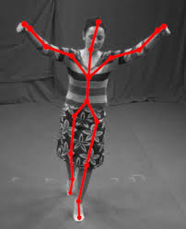

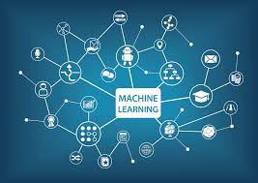
OUR TASK
The purpose of this group project for CS2013/CS3013 for Group 17 is to design a machine learning models to help monitor the developments of gross-motor skills in children..
one model per motion
motion matches model
how many actions performed in each file
Notes:
Dave

Slide 4

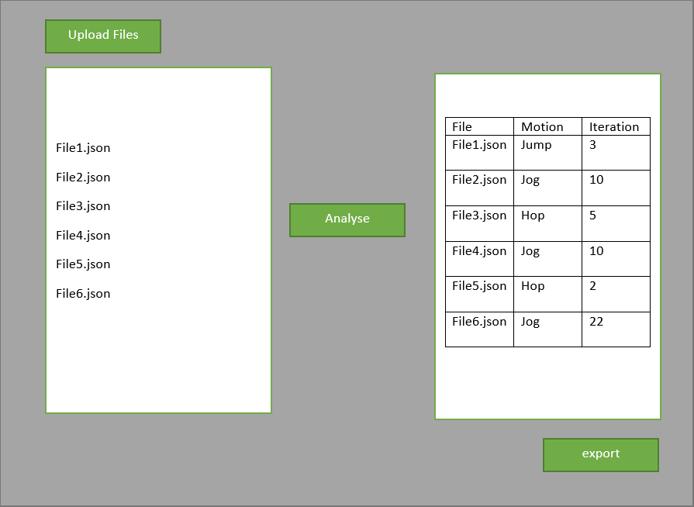
PROPOSED SOLUTION
To create a set of machine learning models for our client to use for his research
one model to detect motion
feed into separate model based on what motion was detected
Each model will track a different motion
determine how many iterations per file
Visual representation
Notes:
Dave

Slide 5


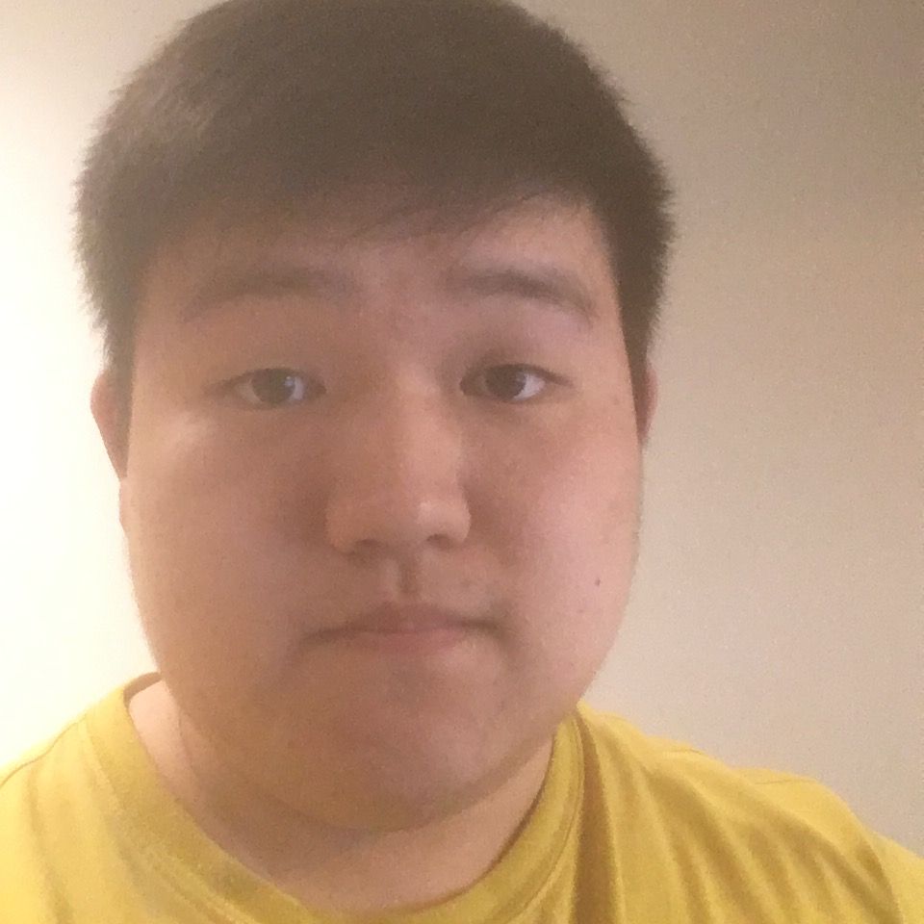

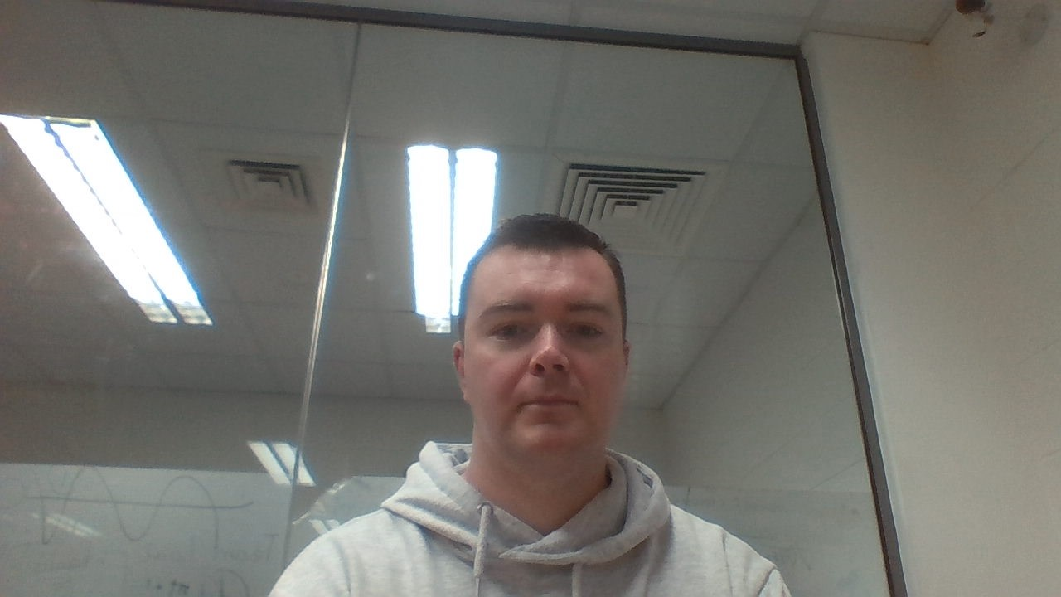
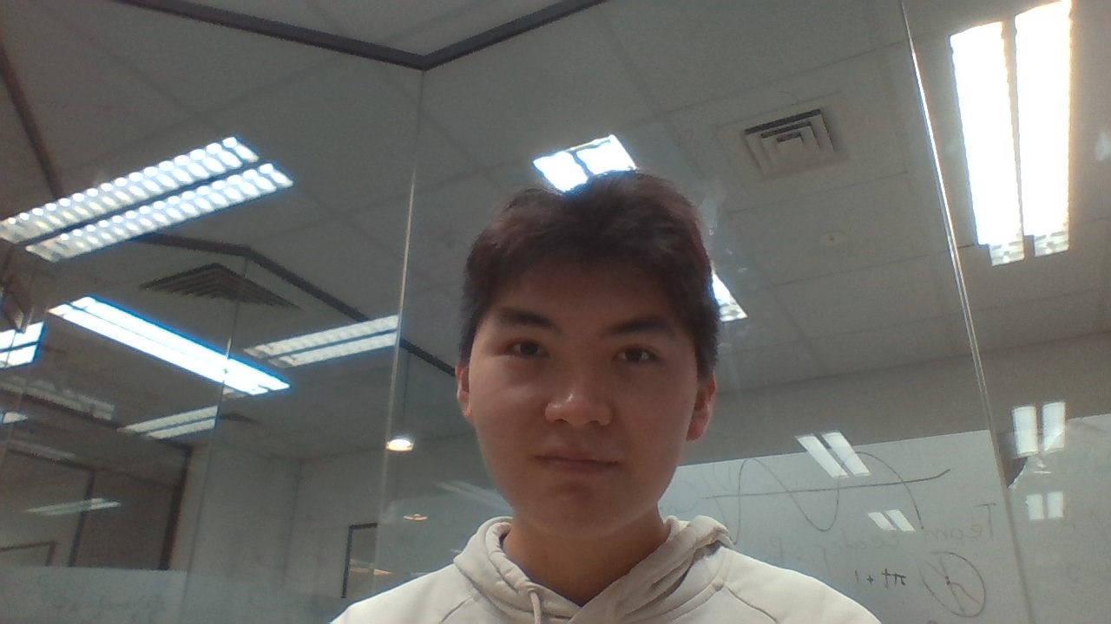
OUR TEAM
Mentor System
3rd Years
Amy Pierce
Shengyuan Liu
He Liu
Team Leader
Backend developer
2nd Years
Dave Kubala
Nicholas Lawlor
Li Koh
Lead 2^{nd Year}
Notes:
Nicholas

Slide 6

Front-end developers
Amy Pierce
Nicholas Lawlor
Li Koh
Lead front end developer
CSB-3rd year
Business studies
Web development
CS- 2^{nd year}
Java programmer
Logical Thinking
CS- 2^{nd year}
UML diagram
Java programmer
Notes:
Nicholas

Slide 7

Back-end developers
Dave Kubala
Shengyuan Liu
He Liu
Lead back end developer
CS- 2^{nd year}
3D-graphics
Unity
CS- 3rd ^{year}
software testing
Test script developer
CS- 3rd ^{year}
Application Developer
Functional Code Writer
Notes:
Nicholas

Slide 8






TOOLS
Notes:
Shengyuan

Slide 9


FUNCTIONAL REQUIREMENTS
Process and parse Json files
Detect what motion is being performed in each file
Detect how many iterations of the motion were performed
80%+ accuracy
Create a file with the results
Notes:
Amy

Slide 10
NON-FUNCTIONAL REQUIREMENTS
High potential for extensibility
Create a GUI to upload the files with
Create an export component
Produce a report for future work to continue
Notes:
Amy

Slide 11
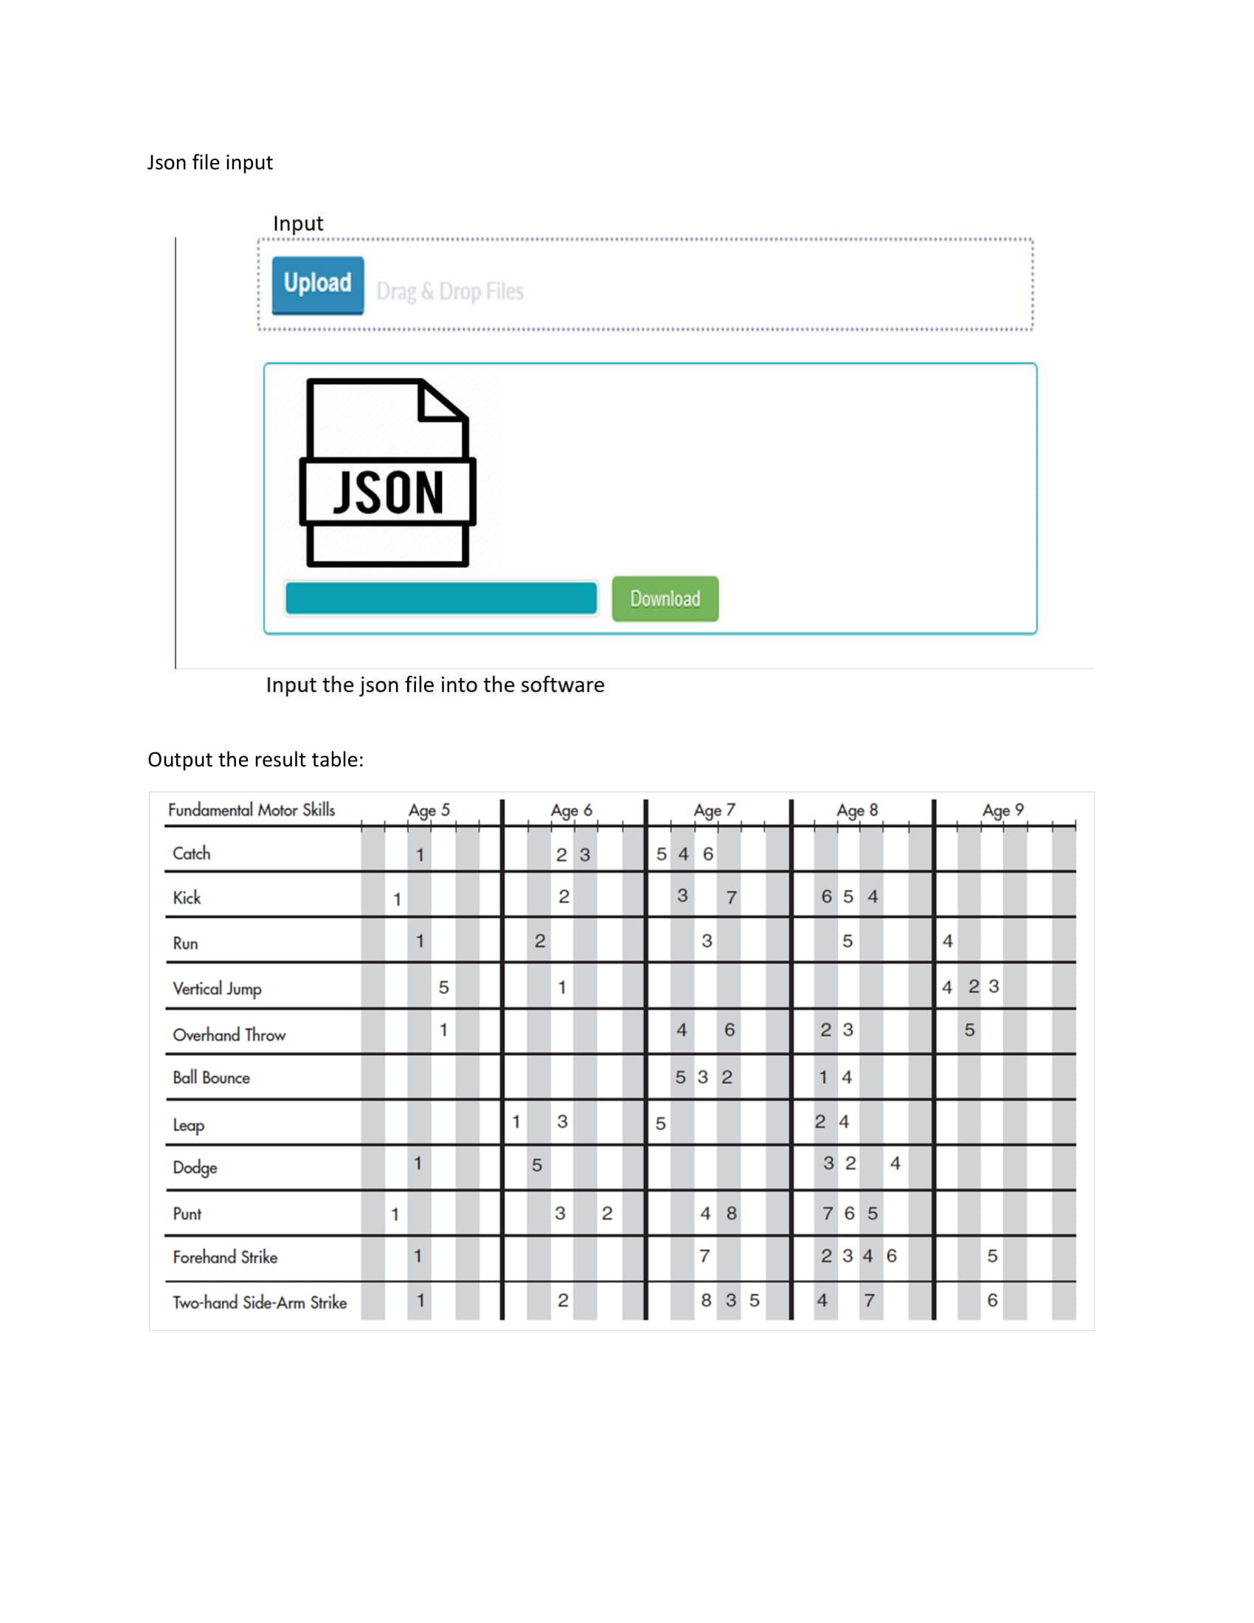
MOCKUPS
Notes:
he

Slide 12
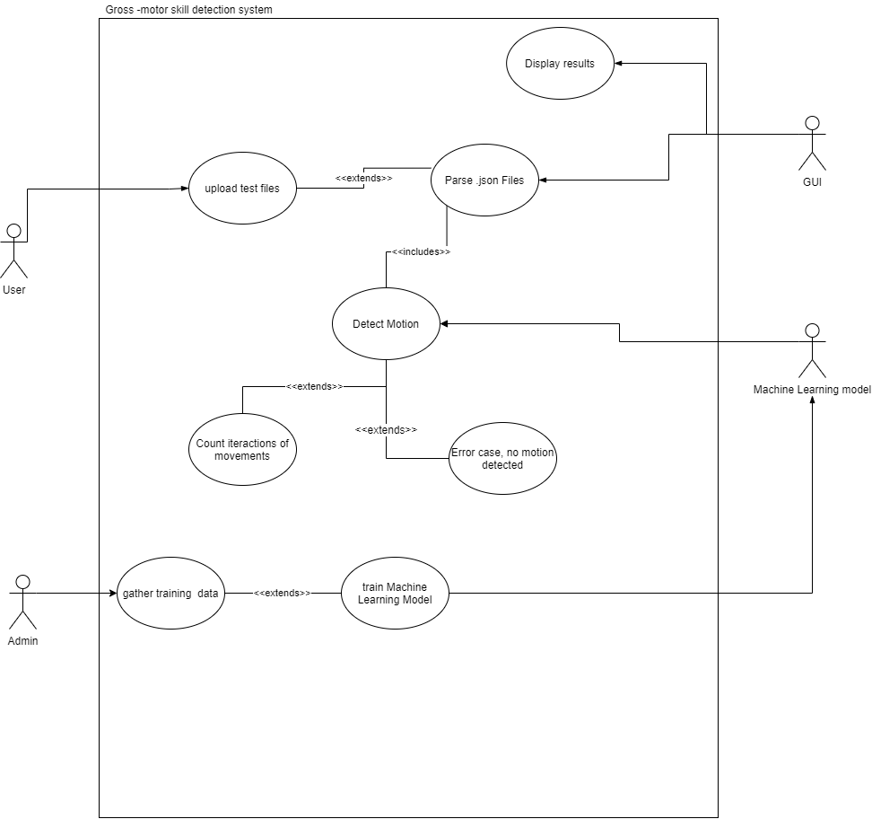
SYSTEM USE CASE
Out lines the proposed functionality of our motion detection system
Four actors
Only admin can training the machine learning model
Users upload to the GUI and data is parsed and passed to machine learning model
GUI displays the results
Error case, the motion in the file is unidentifiable
Notes:
He

Slide 13


THANK YOU!
Group 17
Questions?
Notes:
Shengyaun

